Slide 1
Azure IoT Services Anton Boyko boyko.ant@live.com v-anboyk@microsoft.com

Slide 2
Is IoT even a new thing?
Depending on who you ask, IoT is either:
1
Nothing new
Command and control scenarios have much in common with some parts of IoT.
We’ve been doing this for 40 years
2
A unicorn
But falling hardware costs, cloud services and relatively ubiquitous communications do enable new approaches.
Magic, and will soon change everything.

Slide 3
Software

Slide 4
What is a “Cloud”?
Cloud: on-demand, scalable, multi-tenant, self-service compute and storage resources
Server Provisioning
Cloud Provisioning
Demand
Demand
Time
Overprovisioned
Time
Underprovisioned

Slide 5
Cloud services
Resources
IaaS
PaaS
SaaS
Applications
Applications
You manage
Applications
Applications
Data
You manage
Data
Data
Data
Runtime
Runtime
Runtime
Runtime
Managed by vendor
Middleware
Middleware
Middleware
Middleware
You manage
Managed by vendor
O/S
O/S
O/S
O/S
Virtualization
Virtualization
Managed by vendor
Virtualization
Virtualization
Servers
Servers
Servers
Servers
Storage
Storage
Storage
Storage
Networking
Networking
Networking
Networking
Notes:
Slide Objectives:
Explain the differences and relationship between IaaS, PaaS, and SaaS in more detail.
Speaking Points:
Here’s another way to look at the cloud services taxonomy and how this taxonomy maps to the components in an IT infrastructure.
Packaged Software
With packaged software a customer would be responsible for managing the entire stack – ranging from the network connectivity to the applications.
IaaS
With Infrastructure as a Service, the lower levels of the stack are managed by a vendor. Some of these components can be provided by traditional hosters – in fact most of them have moved to having a virtualized offering.
Very few actually provide an OS
The customer is still responsible for managing the OS through the Applications.
For the developer, an obvious benefit with IaaS is that it frees the developer from many concerns when provisioning physical or virtual machines.
This was one of the earliest and primary use cases for Amazon Web Services Elastic Cloud Compute (EC2).
Developers were able to readily provision virtual machines (AMIs) on EC2, develop and test solutions and, often, run the results ‘in production’.
The only requirement was a credit card to pay for the services.
PaaS
With Platform as a Service, everything from the network connectivity through the runtime is provided and managed by the platform vendor.
The Windows Azure Platform best fits in this category today.
In fact because we don’t provide access to the underlying virtualization or operating system today, we’re often referred to as not providing IaaS.
PaaS offerings further reduce the developer burden by additionally supporting the platform runtime and related application services.
With PaaS, the developer can, almost immediately, begin creating the business logic for an application.
Potentially, the increases in productivity are considerable and, because the hardware and operational aspects of the cloud platform are also managed by the cloud platform provider, applications can quickly be taken from an idea to reality very quickly.
SaaS
Finally, with SaaS, a vendor provides the application and abstracts you from all of the underlying components.

Slide 6

Load Patterns
“On and Off “
“Growing Fast“
Compute
Inactivity
Period
Compute
Average
Usage
Average Usage
Time
Time
On & off workloads (e.g. batch job)
Over provisioned capacity is wasted
Time to market can be cumbersome
Successful services needs to grow/scale
Keeping up w/ growth is big IT challenge
Cannot provision hardware fast enough
“Unpredictable Bursting“
“Predictable Bursting“
Compute
Compute
Average Usage
Time
Time
Unexpected/unplanned peak in demand
Sudden spike impacts performance
Can’t over provision for extreme cases
Services with micro seasonality trends
Peaks due to periodic increased demand
IT complexity and wasted capacity

Slide 7







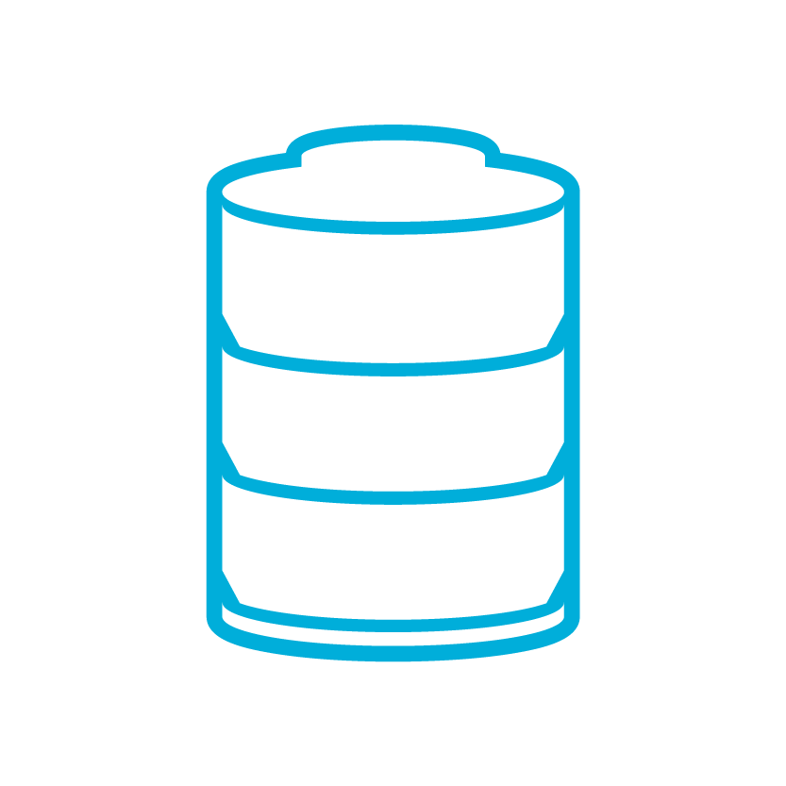




Microsoft Azure IoT services
Producers | Data Transport | Storage | Analysis | Presentation & action
 | IoT Hubs (Service Bus) | SQL Database | Machine Learning | Azure Websites
 | Heterogeneous client agents | Table/Blob Storage | HD Insight/Storm | Mobile Services
 | External Data Sources | DocumentDB | Stream Analytics | Notification Hubs
 |  | External Data Sources | Cloud Services | Power BI
 |  |  |  | External Services
{ }

Slide 8
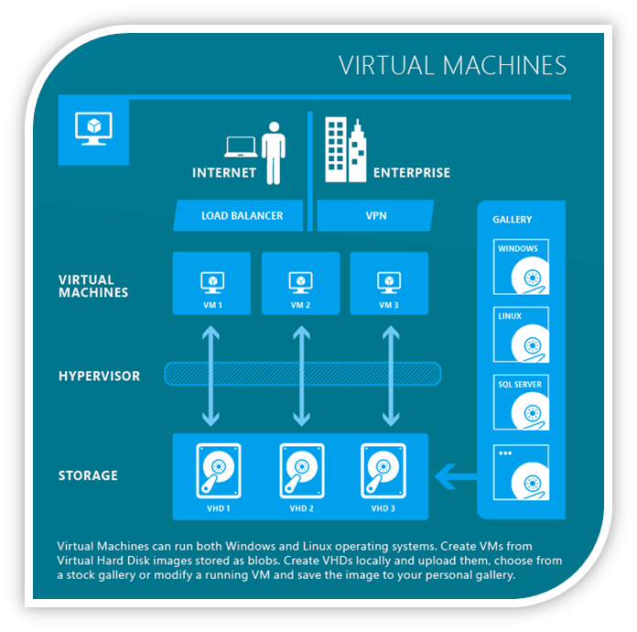
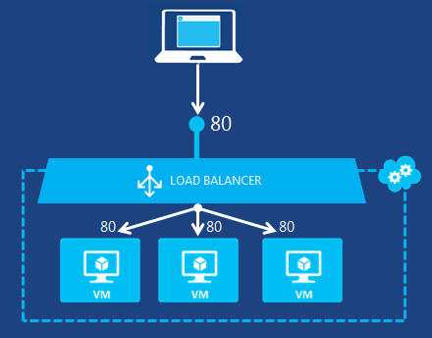
Azure VMs

Slide 9
Windows Azure Storage
Abstractions
Easy client access Easy to use REST APIs and Client Libraries
Existing NTFS APIs for Azure Drives
Blobs
Binary storage in the cloud
Tables
Massively scalable structured storage
Queues
Reliable storage and delivery of messages
Drives
Durable NTFS volumes for Microsoft Azure applications
Files
File system in the cloud

Slide 10

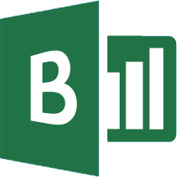

Canonical Stream Analytics Pattern
Event production
Collection
Ingestion
Stream Analysis
Storage and
Batch Analysis
Presentation and action
Event Hubs
Web/thick client dashboards
Applications
Stream Analytics
SQL DB
IoT hubs
Legacy IOT (custom protocols)
Search and query
Storage Tables
Cloud gateways (web APIs)
Devices
Storage Blobs
Data analytics (Power BI)
IP-capable devices (Windows/Linux)
Machine
Learning
Power BI
Low-power devices (RTOS)
Field gateways
Devices to take action
more to come…

Slide 11
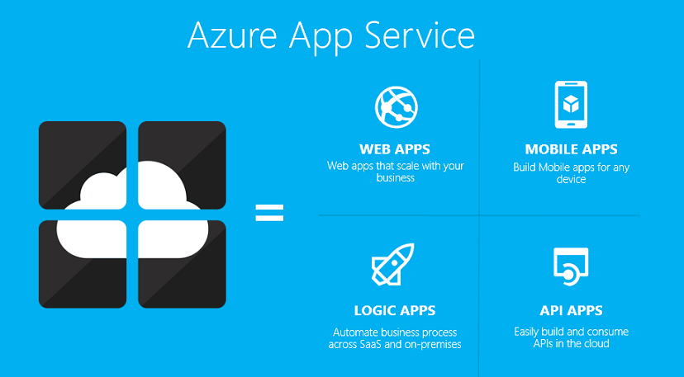
Azure Web Apps?

Slide 12
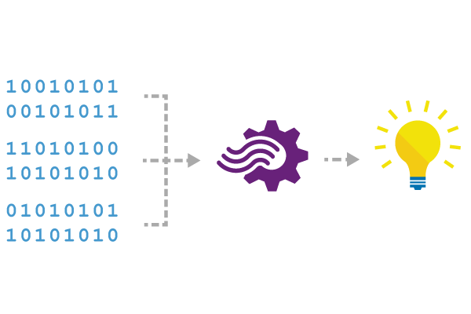
Machine Learning
Azure ML and Stream Analytics are now integrated
The integration is in limited preview as of today!
(see team blog for sign-up information)
Azure ML can publish web endpoints for operationalized models
Azure Stream Analytics can bind custom function names to such web endpoints
Example: apply bound function event-by-event
sentiment mapped to endpoint/API key
SELECT text, sentiment(text) AS score
FROM myStream

Slide 13
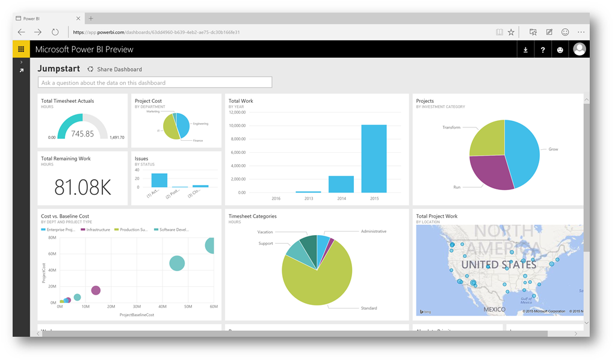
Power BI

Slide 14
Hardware

Slide 15
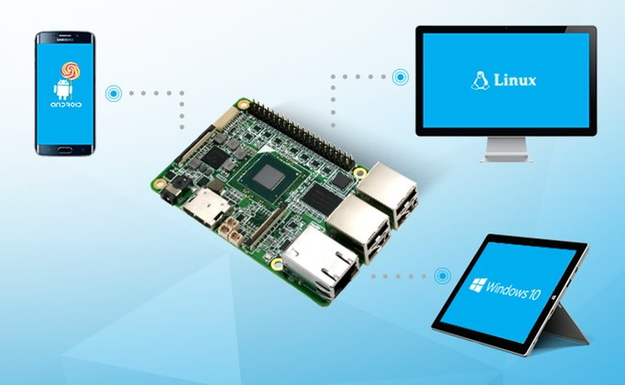
Windows or Linux ?

Slide 16
Links

Slide 17
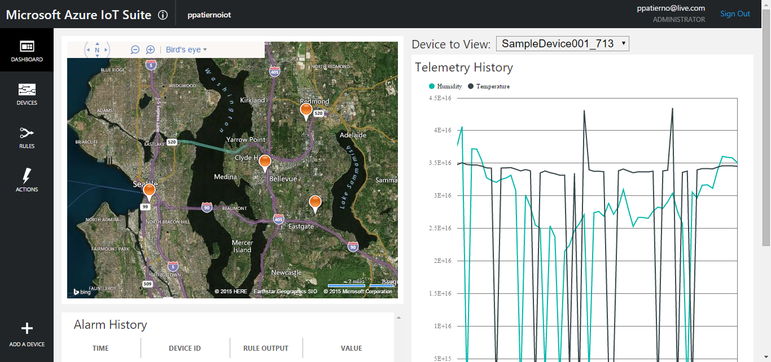
Azure IoT Suite Remote Monitoring
https://www.azureiotsuite.com/

Slide 18
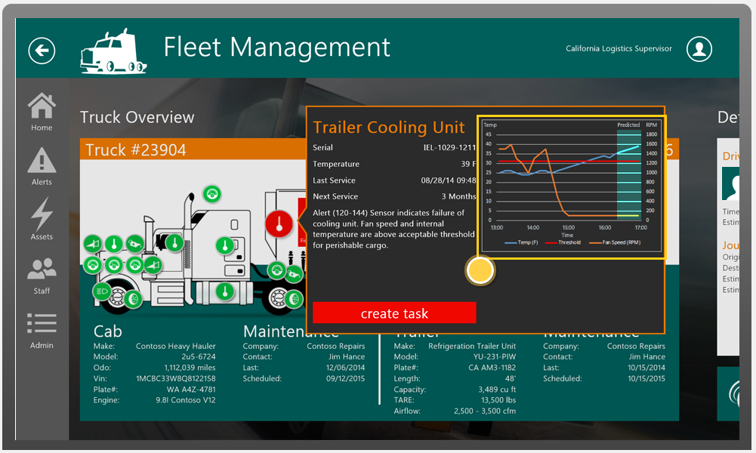
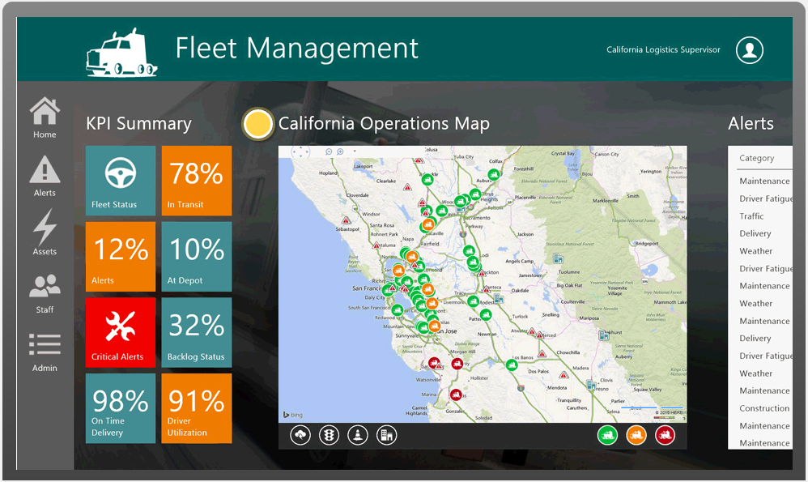
Azure IoT Suite Remote Monitoring Demo
http://www.microsoftazureiotsuite.com/demos/remotemonitoring

Slide 19
References & Links
Azure IoT Hub : https://azure.microsoft.com/en-us/services/iot-hub/
Azure IoT Suite : http://www.azureiotsuite.com
Azure IoT Dev center : http://www.azure.com/iotdev
Azure IoT SDKs : https://github.com/Azure/azure-iot-sdks
Azure Certified IoT : https://azure.microsoft.com/en-us/marketplace/certified-iot-program/
Let’s connect : https://azure.microsoft.com/en-us/develop/iot/get-started/
IoT Protocol Gateway : https://github.com/Azure/azure-iot-protocol-gateway
Azure IoT Remote Monitoring : https://github.com/Azure/azure-iot-remote-monitoring

Slide 20
References & Links
IoT Hub vs AWS IoT : https://paolopatierno.wordpress.com/2015/10/13/an-iot-platforms-match-microsoft-azure-iot-vs-amazon-aws-iot/
IoT Hub connection using AMQP stack :
https://paolopatierno.wordpress.com/2015/10/24/connecting-to-the-azure-iot-hub-using-an-the-amqp-stack/
https://paolopatierno.wordpress.com/2015/10/31/azure-iot-hub-commands-and-feedback-using-amqp-net-lite/
https://paolopatierno.wordpress.com/2015/11/02/azure-iot-hub-get-telemetry-data-using-amqp-stack-and-azure-sb-lite/

Slide 21
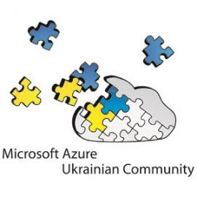
Resources
Microsoft Azure Ukrainian Community
https://www.facebook.com/groups/azure.ua/
Contact Details
Anton Boyko
v-anboyk@microsoft.com
Global Community
https://www.facebook.com/OpennessAtCEE
Events
https://www.facebook.com/OpennessAtCEE/events
Notes:
Slide Objectives:
Provide additional resources
Transition:
I’ve got a few additional resources for you
Speaking Points:
Sign up for a free trial
Check out the Mobile Services dev center for lots of videos, tutorials, and more
The source code for all of the SDKs is available on GitHub and pull requests are accepted.
You can always contact mobileservices@microsoft.com
If you have a feature request, we have a user voice open where you can suggest and vote on future features
Notes:
You may want to put your contact info on this slide as well

Slide 22
Q & A ? Anton Boyko boyko.ant@live.com v-anboyk@microsoft.com

